Slide 1
Technical Security Issues in Cloud Computing
By: Meiko Jensen, Jorg Schwenk, Nils Gruschka, Luigi Lo Lacono
Presentation by: Winston Tong
2009 IEEE

Slide 2
Outline
Background
Cloud Technologies
Web Service Security
Transport Layer Security
Security related Issues
Wrapper Attacks
Browser Security
Metadata Attacks
Flooding Attacks

Slide 3
Background
Cloud layers of service
Software as a Service – Provides ready to use applications (Facebook)
Platform as a Service – Tailored hosting environments (Google App Engine)
Infrastructure as a Service – Provides raw resources (CPU, Storage, Memory)
Security concern – User’s data leaves the home protection of the user and provides trust to the foreign cloud.

Slide 4
Cloud Technologies – Web Service Security
Provide integrity, confidentiality and authentication for SOAP messages.
SOAP messages – Organized XML type message
Defines a SOAP header that carries WS-Security extensions.
Defines XML Signature/Encryption application to SOAP messages.
Hybrid Encryption
XML fragment is encrypted with a randomly generated symmetric key.
Key is encrypted with public key of recipient.
Encrypted key is inside security header.

Slide 5
Transport Layer Security
Handshake
Establishes encryption keys and algorithms
Authenticate server and client
Record Layer
Encrypts/decrypts TCP data streams using keys and algorithms from handshake.
Has different options for key agreement, encryption and authentication.
Popular
Certificate authentication of servers
User/Password authentication of clients

Slide 6
Cloud Security Issues – XML Signature
XML Signature Element Wrapping (Wrapping Attack)
Allows an outsider to freely use a victim’s cloud.
Example
Client sends SOAP message asking for “me.jpg” in the message “body”.
Client signature is in SOAP header and points to signed message for “body”.
Attacker can intercept the message and manipulate “body” in such a way that it asks for something else.
The message will still contain the valid signature.
2008, Amazon EC2 services were vulnerable to wrapping attacks.

Slide 7
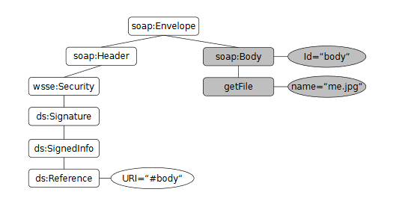
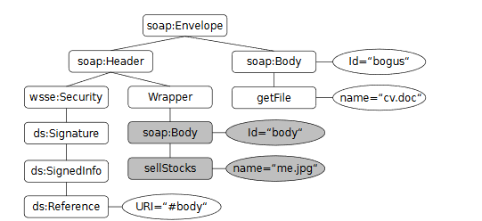
Cloud Security Issues – XML Signature

Slide 8
Cloud Security Issues – Browser Security
Client usage of the browser as a tool to access his cloud leaves him vulnerable to browser attacks.
In response, Cloud services use Federated Identity Management (FIM) protocols.
Authentication through a third party. (With credentials)
When authenticated, Kerberos tokens are sent to the server.
These tokens are vulnerable.
Browsers unable to issue XML based security tokens itself.
FIM tokens are stored in the browser and are only protected by standard operating procedures.

Slide 9
Cloud integrity and Binding Issues
Clouds use metadata for identification of type of service that users want.
Malware Injection Attacks
Adversary creates his own service module and adds it to the cloud system
The cloud will then unknowingly service a user the malicious module.
Metadata Spoofing
Maliciously reengineering the Web Services’ metadata descriptions
Ex: deleteUser -> setAdminRights
These two attacks are weaker and avoidable

Slide 10
Flooding Attacks
Attacker sending a huge load of nonsense to service
Direct Denial of Service
Cloud wastes its resources on a flooded service.
Indirect Denial of Service
The flooded service affects the availability to other services
Accounting and Accountability
Economic loss from the computational power usage

Slide 11
Conclusion
Favor XML Signature and encryption security in browsers.
Strengthen security capabilities of browsers and Web Service frameworks.
Strengthen TLS to protect the SAML tokens
TLS session binding – the token will be protected by the same channel.
Strong Locked same origin policy – use server key as authentication as opposed to the insecure DNS system.

